Slide 1
Machine Learning Methods and Tools
Elena Zennaro, Wolfgang Ecker, Lorenzo Servadei

Slide 2
Introduction to Feed Forward Neural Networks
Elena Zennaro, Wolfgang Ecker, Lorenzo Servadei

Slide 3
Outline
Optimization
Computational Graphs
Neural Networks
Intuition
Theory

Slide 4
Optimization

Slide 5
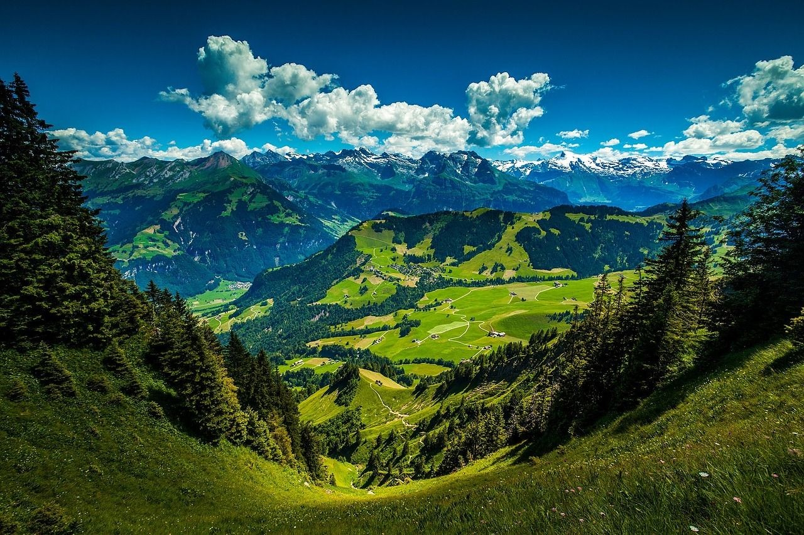
Optimization
This image is CC0 1.0 public domain

Slide 6

Optimization
Walking man image is CC0 1.0 public domain

Slide 7
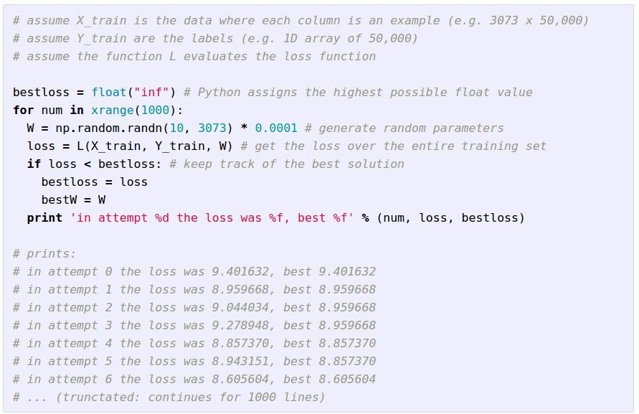
Strategy #1: A first very bad idea solution: Random search
Optimization

Slide 8
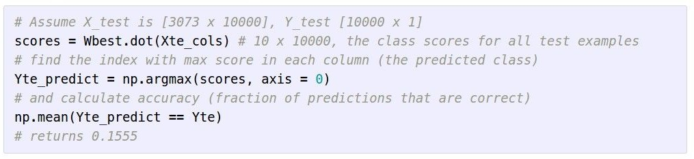
Lets see how well this works on the test set...
Optimization
15.5% accuracy! not bad! (SOTA is ~95%)

Slide 9
Strategy #2: Follow the slope
Optimization

Slide 10
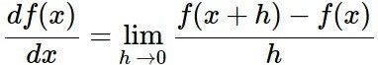
Strategy #2: Follow the slope
Gradient
In 1-dimension, the derivative of a function:
In multiple dimensions, the gradient is the vector of (partial derivatives) along each dimension
The slope in any direction is the dot product of the direction with the gradient The direction of steepest descent is the negative gradient

Slide 11
current W:
Optimization Example
gradient dW:
[0.34,
-1.11,
0.78,
0.12,
0.55,
2.81,
-3.1,
-1.5,
0.33,…]
loss 1.25347
[?,
?,
?,
?,
?,
?,
?,
?,
?,…]

Slide 12
current W:
Optimization Example
W + h (first dim):
gradient dW:
[0.34,
-1.11,
0.78,
0.12,
0.55,
2.81,
-3.1,
-1.5,
0.33,…]
loss 1.25347
[0.34 + 0.0001,
-1.11,
0.78,
0.12,
0.55,
2.81,
-3.1,
-1.5,
0.33,…]
loss 1.25322
[?,
?,
?,
?,
?,
?,
?,
?,
?,…]

Slide 13
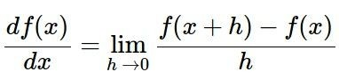
current W:
Optimization Example
W + h (first dim):
gradient dW:
[0.34,
-1.11,
0.78,
0.12,
0.55,
2.81,
-3.1,
-1.5,
0.33,…]
loss 1.25347
[0.34 + 0.0001,
-1.11,
0.78,
0.12,
0.55,
2.81,
-3.1,
-1.5,
0.33,…]
loss 1.25322
[-2.5,
?,
?,
?,
?,
?,
?,
(1.25322 - 1.25347)/0.0001
= -2.5
?,
?,…]

Slide 14
current W:
Optimization Example
W + h
(second dim):
gradient dW:
[0.34,
-1.11,
0.78,
0.12,
0.55,
2.81,
-3.1,
-1.5,
0.33,…]
loss 1.25347
[0.34,
-1.11 + 0.0001,
0.78,
0.12,
0.55,
2.81,
-3.1,
-1.5,
0.33,…]
loss 1.25353
[-2.5,
?,
?,
?,
?,
?,
?,
?,
?,…]

Slide 15
current W:
Optimization Example
W + h (second dim):
gradient dW:
[0.34,
-1.11,
0.78,
0.12,
0.55,
2.81,
-3.1,
-1.5,
0.33,…]
loss 1.25347
[0.34,
-1.11 + 0.0001,
0.78,
0.12,
0.55,
2.81,
-3.1,
-1.5,
0.33,…]
loss 1.25353
[-2.5,
0.6,
?,
?,
?,
(1.25353 - 1.25347)/0.0001
= 0.6
?,
?,
?,
?,
?,…]

Slide 16
current W:
Optimization Example
W + h (third dim):
gradient dW:
[0.34,
-1.11,
0.78,
0.12,
0.55,
2.81,
-3.1,
-1.5,
0.33,…]
loss 1.25347
[0.34,
-1.11,
0.78 + 0.0001,
0.12,
0.55,
2.81,
-3.1,
-1.5,
0.33,…]
loss 1.25347
[-2.5,
0.6,
?,
?,
?,
?,
?,
?,
?,…]

Slide 17
current W:
Optimization Example
W + h (third dim):
gradient dW:
[0.34,
-1.11,
0.78,
0.12,
0.55,
2.81,
-3.1,
-1.5,
0.33,…]
loss 1.25347
[0.34,
-1.11,
0.78 + 0.0001,
0.12,
0.55,
2.81,
-3.1,
-1.5,
0.33,…]
loss 1.25347
[-2.5,
0.6,
0,
?,
?,
?,
?
(1.25347 - 1.25347)/0.0001
= 0
?,…]

Slide 18
current W:
Optimization Example
W + h (third dim):
gradient dW:
[0.34,
-1.11,
0.78,
0.12,
0.55,
2.81,
-3.1,
-1.5,
0.33,…]
loss 1.25347
[0.34,
-1.11,
0.78 + 0.0001,
0.12,
0.55,
2.81,
-3.1,
-1.5,
0.33,…]
loss 1.25347
[-2.5,
0.6,
0,
?,
Numeric Gradient
,
?,
?,
?,
Slow! Need to loop over all dimensions
Approximate
?,…]

Slide 19
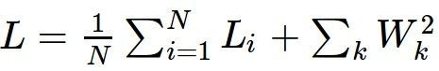
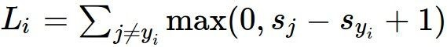
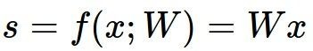
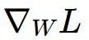
How to proceed
This is silly. The loss is just a function of W:
want

Slide 20
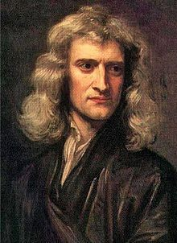
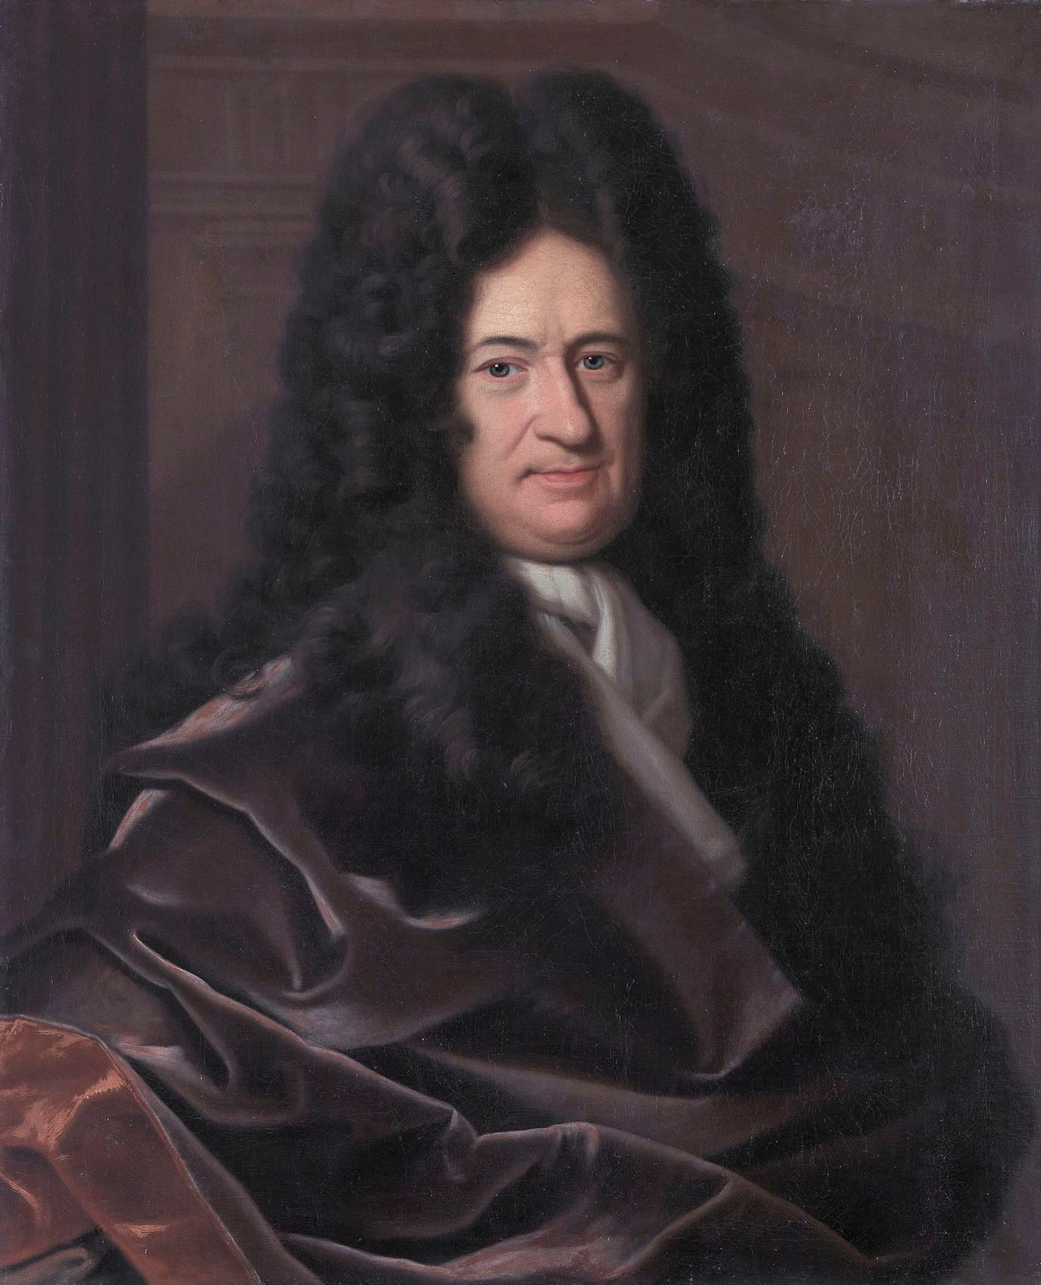
This is silly. The loss is just a function of W:
How to proceed
Hammer image is in the public domain
want
Use calculus to compute an
analytic gradient
This image is in the public domain
This image is in the public domain

Slide 21
current W:
Analytical Gradient
gradient dW:
[0.34,
-1.11,
0.78,
0.12,
0.55,
2.81,
-3.1,
-1.5,
0.33,…]
loss 1.25347
[-2.5,
0.6,
0,
0.2,
0.7,
-0.5,
1.1,
1.3,
-2.1,…]
dW = ...
(some function data and W)

Slide 22
In summary:
Analytical Gradient
Numerical gradient: approximate, slow, easy to write
Analytic gradient: exact, fast, error-prone
=>
In practice: Always use analytic gradient, but check implementation with numerical gradient. This is called a gradient check.

Slide 23
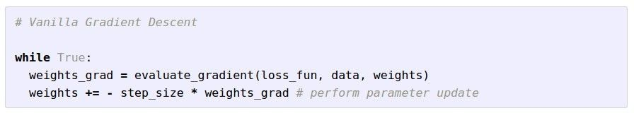
Analytical Gradient

Slide 24
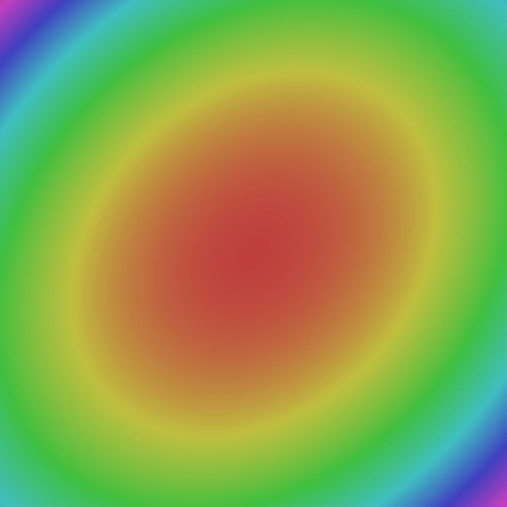

Analytical Gradient
W_2
original W
W_1
negative gradient direction

Slide 25
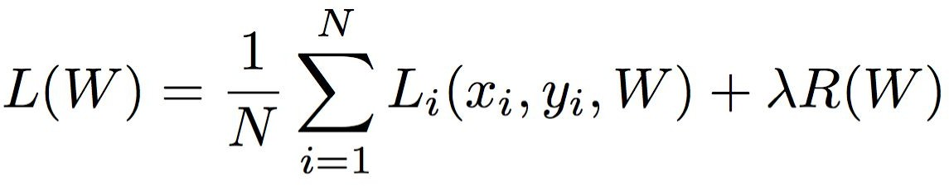
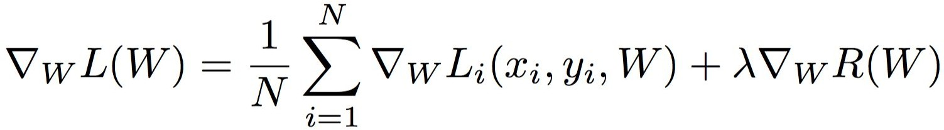
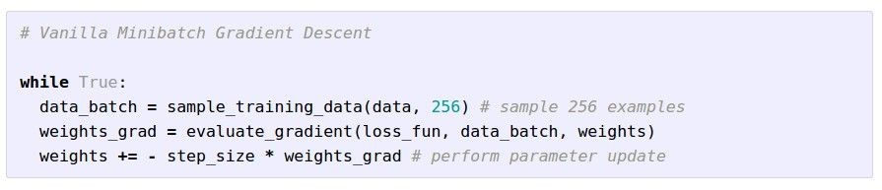
Stochastic Gradient Descent (SGD)
Full sum expensive when N is large!
Approximate sum using a minibatch of examples
32 / 64 / 128 common

Slide 26
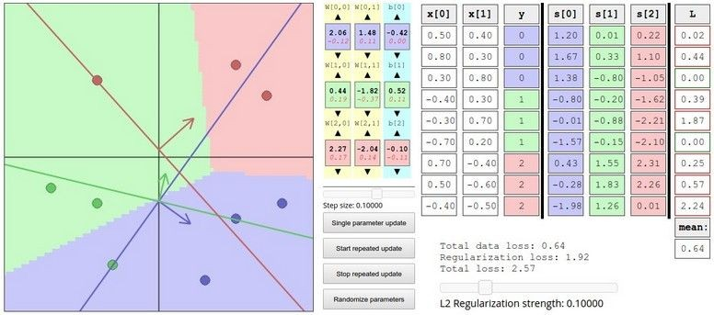
Interactive Web Demo time....
Demo
http://vision.stanford.edu/teaching/cs231n-demos/linear-classify/

Slide 27
Outline
Optimization
Computational Graphs
Neural Networks
Intuition
Theory

Slide 28
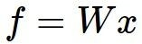
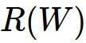
Computational graphs
x
*
s (scores)
hinge loss
+
L
W
R

Slide 29
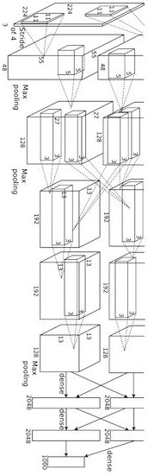
Convolutional network (AlexNet)
input image
weights loss
Figure copyright Alex Krizhevsky, Ilya Sutskever, and Geoffrey Hinton, 2012. Reproduced with permission.

Slide 30
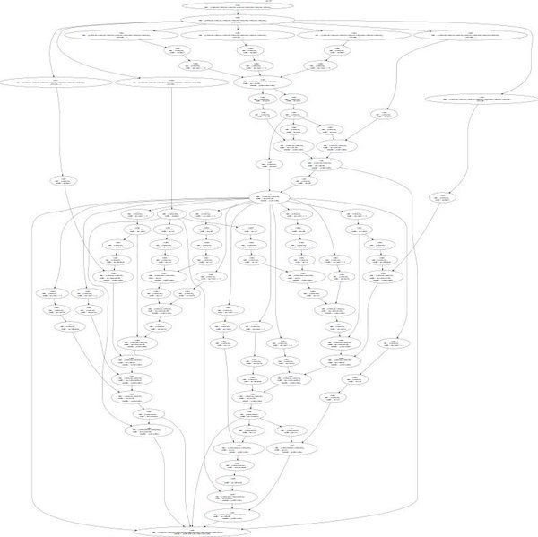
Neural Turing Machine
input image
loss
Figure reproduced with permission from a Twitter post by Andrej Karpathy.

Slide 32
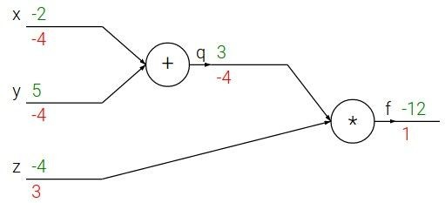
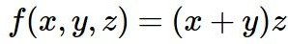
Backpropagation: a simple example
e.g. x = -2, y = 5, z = -4

Slide 33
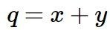
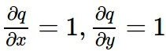
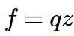
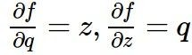
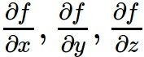
Backpropagation: a simple example
e.g. x = -2, y = 5, z = -4
Want:

Slide 34
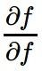
Backpropagation: a simple example
e.g. x = -2, y = 5, z = -4
Want:

Slide 35
Backpropagation: a simple example
e.g. x = -2, y = 5, z = -4
Want:

Slide 36
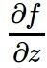
Backpropagation: a simple example
e.g. x = -2, y = 5, z = -4
Want:

Slide 37
Backpropagation: a simple example
e.g. x = -2, y = 5, z = -4
Want:

Slide 38
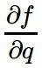
e.g. x = -2, y = 5, z = -4
Want:

Slide 39
Backpropagation: a simple example
e.g. x = -2, y = 5, z = -4
Want:

Slide 40
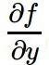
Backpropagation: a simple example
e.g. x = -2, y = 5, z = -4
Want:

Slide 41
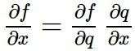
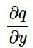
Backpropagation: a simple example
e.g. x = -2, y = 5, z = -4
Chain rule:
Want:

Slide 42
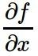
Backpropagation: a simple example
e.g. x = -2, y = 5, z = -4
Want:

Slide 43
Backpropagation: a simple example
e.g. x = -2, y = 5, z = -4
Chain rule:
Want:

Slide 44
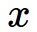
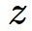
f

Slide 45
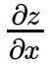
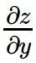
f
“local gradient”

Slide 46
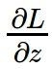
f
“local gradient”
gradients

Slide 47
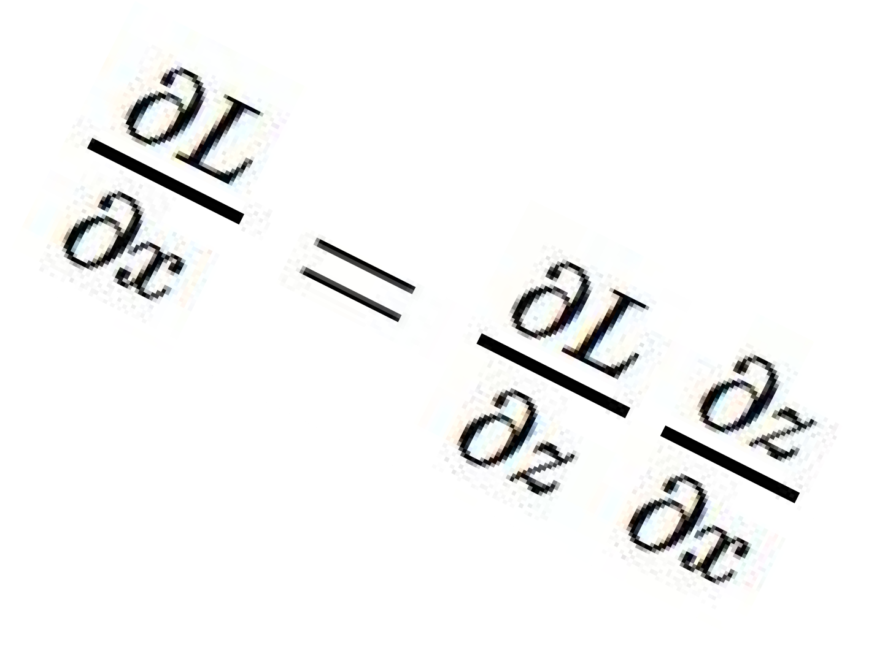
f
“local gradient”
gradients

Slide 48
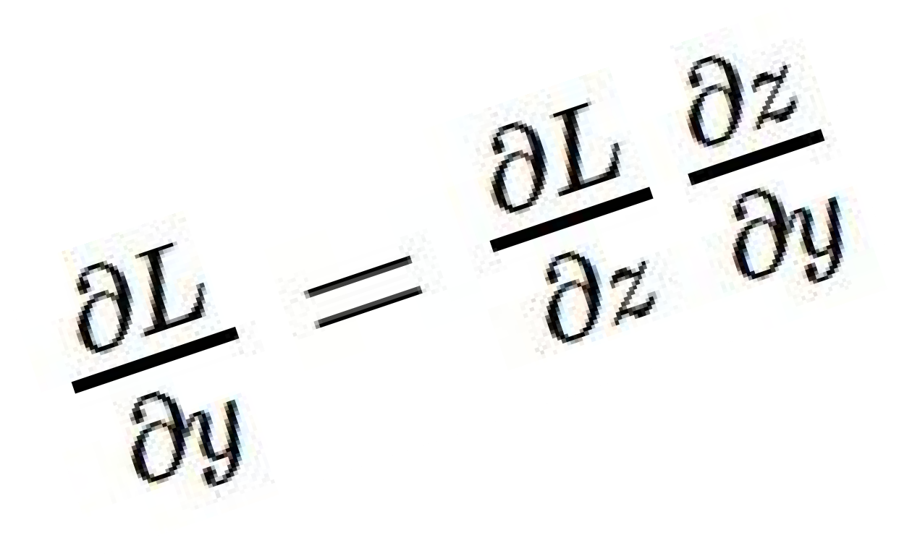
f
“local gradient”
gradients

Slide 49
f
“local gradient”
gradients

Slide 50
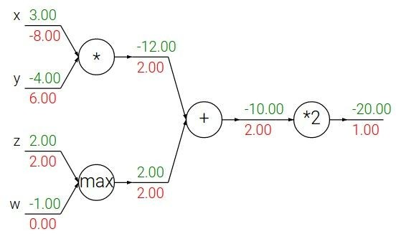
Patterns in backward flow
add gate: gradient distributor

Slide 51
Patterns in backward flow
add gate: gradient distributor
Q: What is a max gate?

Slide 52
Patterns in backward flow
add gate: gradient distributor
max gate: gradient router

Slide 53
Patterns in backward flow
add gate: gradient distributor
max gate: gradient router
Q: What is a mul gate?

Slide 54
Patterns in backward flow
add gate: gradient distributor
max gate: gradient router
mul gate: gradient switcher

Slide 55
Gradients add at branches
+

Slide 56
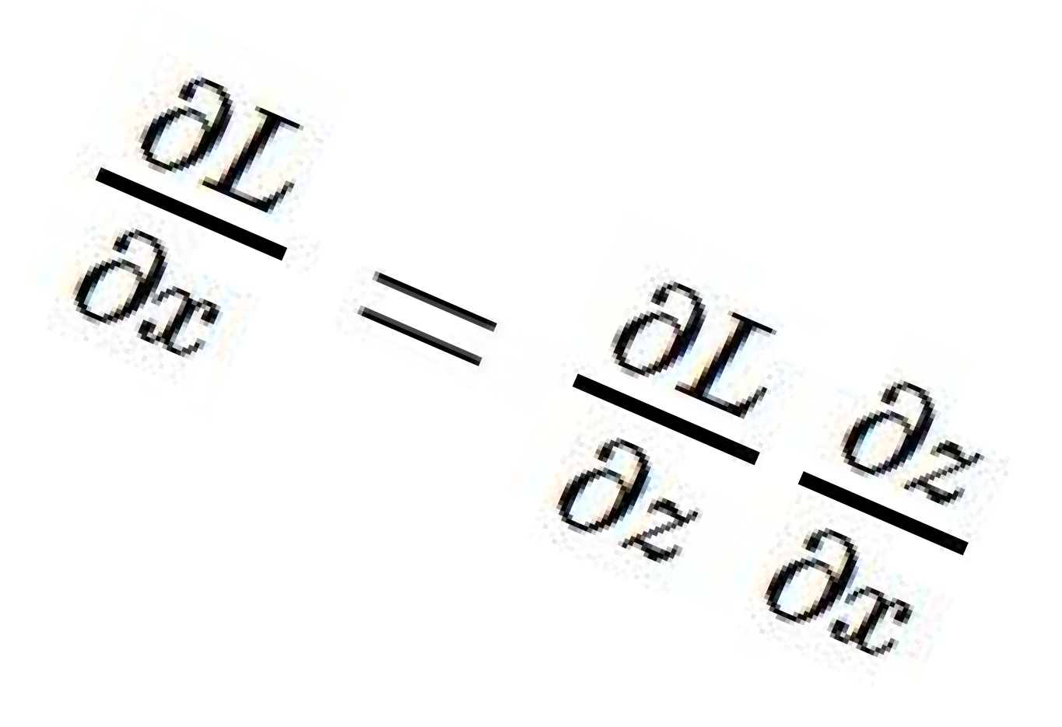
Gradients for vectorized code
(x,y,z are now vectors)
This is now the Jacobian matrix (derivative of each element of z w.r.t. each element of x)
“local gradient”
f
gradients

Slide 57
Vectorized operations
f(x) = max(0,x) (elementwise)
4096-d
input vector
4096-d
output vector

Slide 58
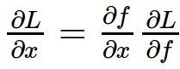
Vectorized operations
f(x) = max(0,x) (element- wise)
4096-d
input vector
Q: what is the size of the Jacobian matrix?
4096-d
output vector
Jacobian matrix

Slide 59
Vectorized operations
Jacobian matrix
f(x) = max(0,x) (element- wise)
4096-d
input vector
Q: what is the size of the Jacobian matrix? [4096 x 4096!]
4096-d
output vector

Slide 60
Vectorized operations
f(x) = max(0,x) (element- wise)
4096-d
input vector
Q: what is the size of the Jacobian matrix? [4096 x 4096!]
4096-d
output vector
in practice we process an entire minibatch (e.g. 100) of examples at one time:
i.e. Jacobian would technically be a [409,600 x 409,600] matrix :\

Slide 61
Vectorized operations
Jacobian matrix
4096-d
output vector
Q2: what does it look like?
f(x) = max(0,x) (element- wise)
4096-d
input vector
Q: what is the size of the Jacobian matrix? [4096 x 4096!]

Slide 62
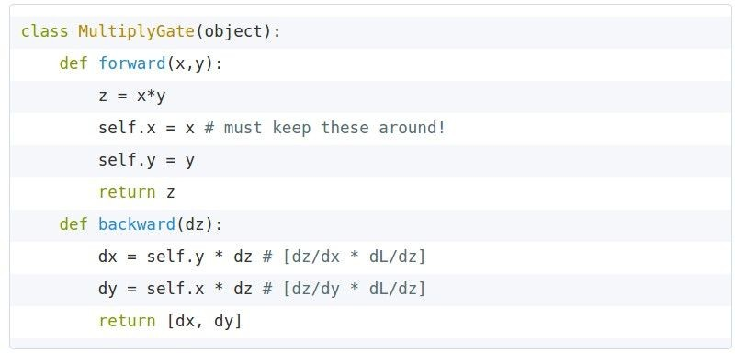
Modularized implementation: forward / backward API
x
z
*
y
(x,y,z are scalars)

Slide 63
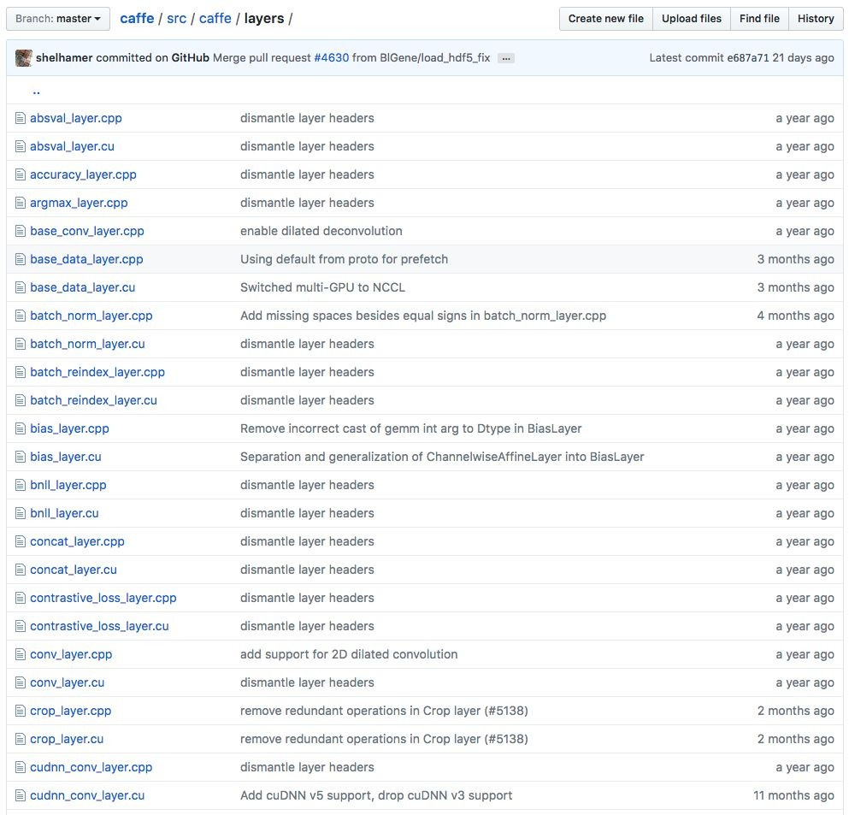
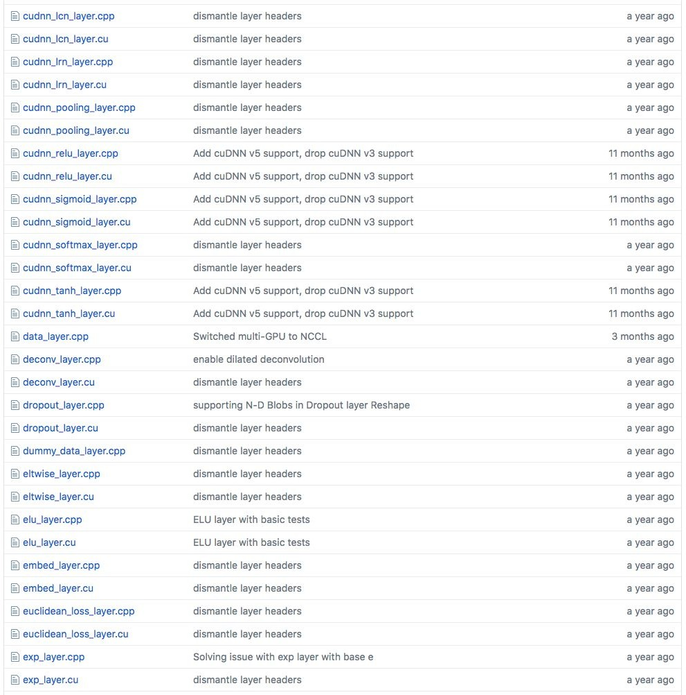
Example: Caffe layers
Caffe is licensed under BSD 2-Clause

Slide 64
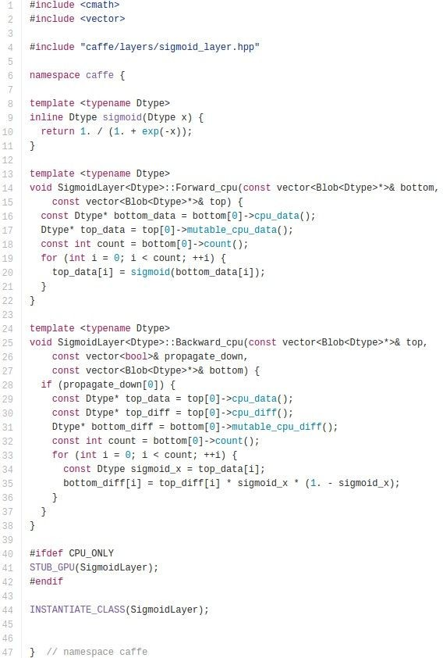
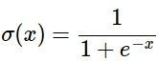

Caffe Sigmoid Layer
* top_diff
(chain rule)
Caffe is licensed under BSD 2-Clause

Slide 65
Summary so far...
neural nets will be very large: impractical to write down gradient formula by hand for all parameters
backpropagation = recursive application of the chain rule along a computational graph to compute the gradients of all inputs/parameters/intermediates
implementations maintain a graph structure, where the nodes implement the forward() / backward() API
forward: compute result of an operation and save any intermediates needed for gradient computation in memory
backward: apply the chain rule to compute the gradient of the loss function with respect to the inputs

Slide 66
Outline
Optimization
Computational Graphs
Neural Networks
Intuition
Theory

Slide 67
Next: Neural Networks

Slide 68

Neural networks: without the brain stuff
(Before) Linear score function:

Slide 69

Neural networks: without the brain stuff
(Before) Linear score function:
(Now) 2-layer Neural Network

Slide 70
(Before) Linear score function: (Now) 2-layer Neural Network
Neural networks: without the brain stuff
x
h
W1
W2
s
3072
100
10

Slide 71

(Before) Linear score function: (Now) 2-layer Neural Network
Neural networks: without the brain stuff
x
h
W1
W2
s
3072
100
10

Slide 72
Neural networks: without the brain stuff
(Before) Linear score function:
(Now) 2-layer Neural Network
or 3-layer Neural Network

Slide 73

Full implementation of training a 2-layer Neural Network needs ~20 lines:

Slide 74
Be very careful with your brain analogies!
Biological Neurons:
Many different types
Dendrites can perform complex non-linear computations
Synapses are not a single weight but a complex non-linear dynamical system
Rate code may not be adequate
[Dendritic Computation. London and Hausser]

Slide 75











Activation functions
Sigmoid
tanh
Leaky ReLU
Maxout
ReLU
ELU

Slide 76


Neural networks: Architectures
“2-layer Neural Net”, or
“1-hidden-layer Neural Net”
“3-layer Neural Net”, or
“2-hidden-layer Neural Net”
“Fully-connected” layers

Slide 77

Example feed-forward computation of a neural network

Slide 78
Summary
We arrange neurons into fully-connected layers
The abstraction of a layer has the nice property that it allows us to use efficient vectorized code (e.g. matrix multiplies)
Neural networks are not really neural

Slide 79

Fully Connected Layer
32x32x3 image -> stretch to 3072 x 1
input
activation
1
1
10 x 3072
weights
3072
10

Slide 80
Fully Connected Layer
32x32x3 image -> stretch to 3072 x 1
input
activation
1
1
10 x 3072
weighs
3072
10
1 number:
the result of taking a dot product between a row of W and the input (a 3072-dimensional dot product)

Slide 81
Outline
Optimization
Computational Graphs
Neural Networks
Intuition
Theory

Slide 82


Slide 83


Slide 84


Slide 85




Two non-separable cases

Slide 86

First case

Slide 87


Slide 88

Lesson learned
Looking at the data before choosing the model and be hazardous to your E_{out}
Data snooping

Slide 89
Logistic regression - Outline
The model
Error measure
Learning algorithm

Slide 90

Generalized Linear Models

Slide 91


Slide 92


Slide 93


Slide 94


Slide 95


Slide 96


Slide 97
Logistic regression - Outline
The model
Error measure
Learning algorithm

Slide 98


Slide 99


Slide 100


Slide 101


Slide 102


Slide 103


Slide 104


Slide 105


Slide 106


Slide 107


Slide 108


Slide 109


Slide 110


Slide 111


Slide 112


Slide 113


Slide 114


Slide 115


Slide 116


Slide 117


Slide 118


Slide 119


Slide 120


Slide 121


Slide 122
Sources
https://work.caltech.edu/telecourse
http://cs231n.stanford.edu/2017/syllabus.html

